Slide 1


LUNG CANCER PREDICTION
REPORT
MADE BY: AHMED ESSAM

Slide 2
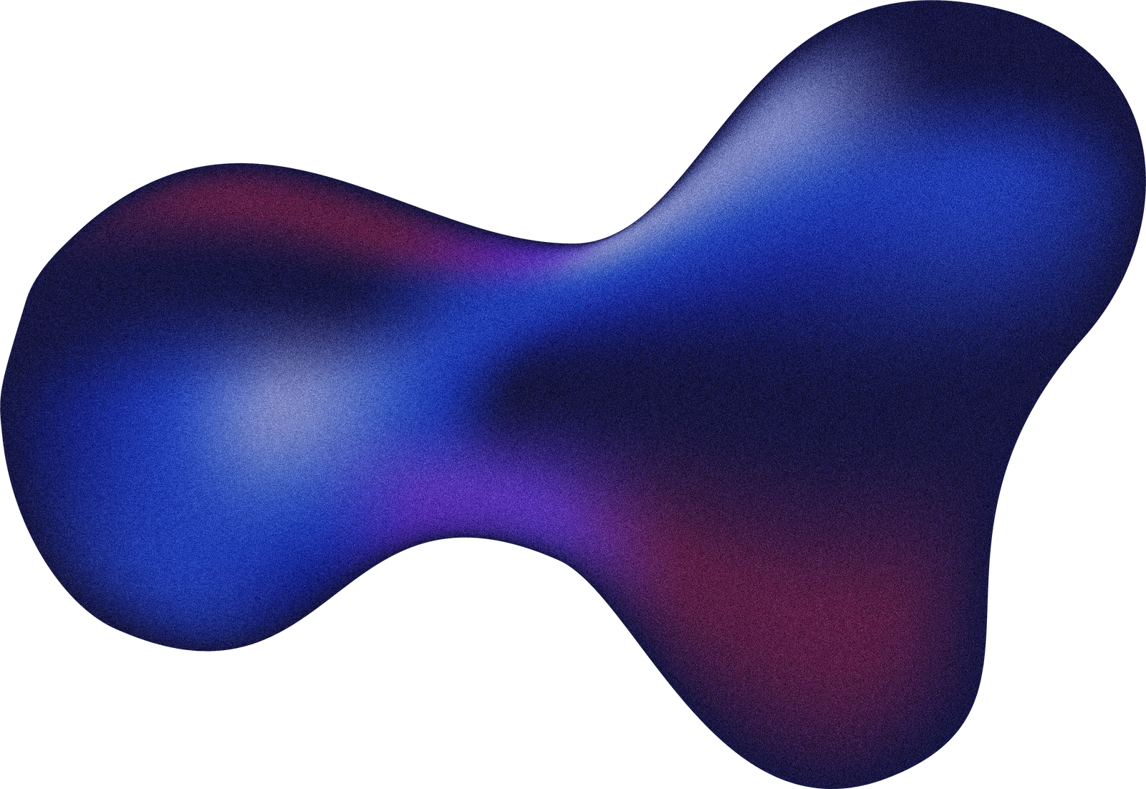
Table of Contents
Table of Contents
Executive Summary
The Story the Data Tells
Decision Tree Insights
Analysis
Model Performance
Why the Models Achieved 100 percent Accuracy
Conclusion and Recommendations

Slide 3
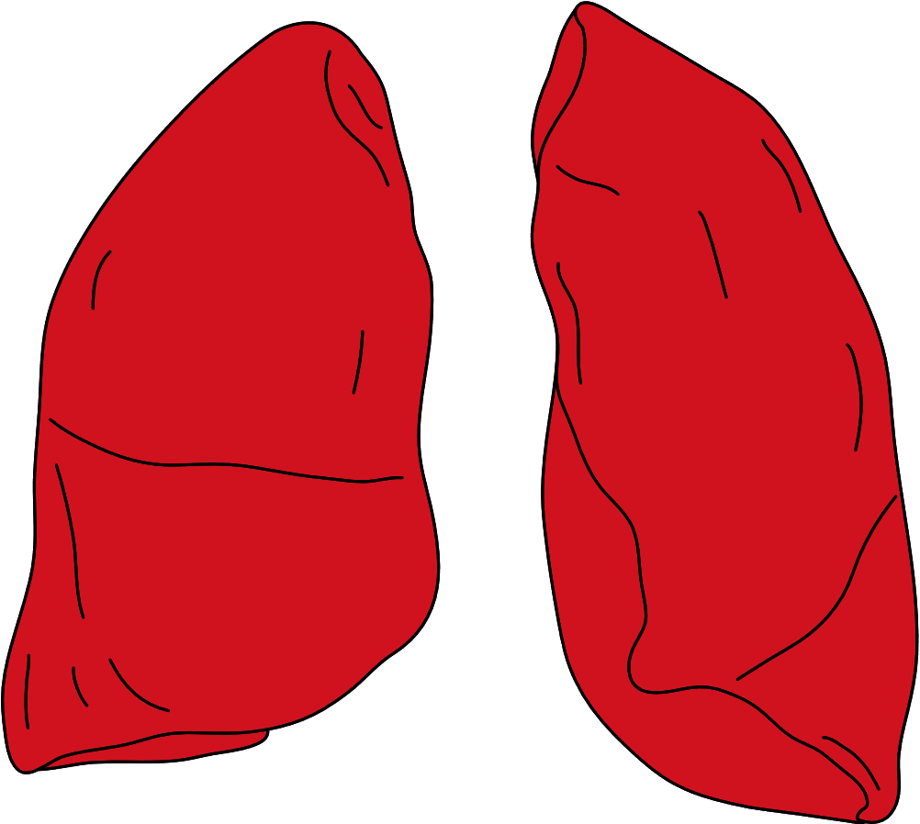
Executive Summary
This report analyzes lung cancer severity using patient data that includes lifestyle factors, symptoms, genetic risk, and environmental exposures. The data shows clear separation between Low, Medium, and High severity levels. Strong predictors such as smoking, shortness of breath, wheezing, genetic risk, and obesity rise consistently with severity. Statistical tests confirm significant differences across groups. Machine learning models reach high accuracy because the dataset has structured patterns with clean class boundaries. These insights support faster screening and better identification of high‑risk patients.
Goal
Who Are We Helping?
This project aims to identify the most important factors that influence lung cancer severity and evaluate how well different machine learning models predict the severity level. The goal is to understand the patterns in the data and determine which variables contribute most to accurate risk assessment.
This analysis supports healthcare professionals who need quick and reliable indicators to identify patients at higher risk of severe lung cancer. These insights help guide early intervention, improve patient triage, and support data‑driven decision making.
1

Slide 4
The Story the Data Tells
Population
The dataset includes 1000 patients with ages ranging from 14 to 73. Most fall between 25 and 50 years old. Cancer levels are balanced across Low, Medium, and High groups.
Risk Factors
Risk indicators such as smoking, air pollution exposure, obesity, passive smoking, and genetic risk increase sharply with cancer severity. High‑severity cases show the highest scores across these factors.
Symptoms
Respiratory symptoms including shortness of breath, wheezing, coughing blood, and chest pain rise consistently from Low to Medium to High severity. High‑severity groups show the most intense symptom profiles.
Statistical Tests
Statistical analysis confirms strong differences between groups. Age shows significant variation across severity levels. Smoking and genetic risk have extremely strong associations with severity. Non‑parametric tests show that symptom severity differs clearly between groups.
Models
Multiple machine learning models were trained, and most achieved perfect classification. The clean structure of the dataset and strong separation between severity levels make prediction straightforward.
2

Slide 5
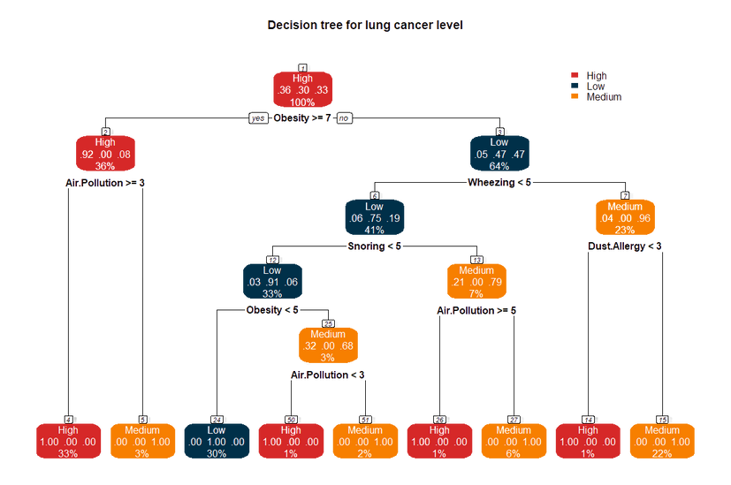
Decision Tree Insights
The decision tree provides a clear and interpretable view of how different factors contribute to lung cancer severity. Each decision split organizes patients based on strong predictors such as obesity, wheezing, snoring, air pollution, and dust allergy. The tree structure reveals several
patterns:
High severity appears when obesity is high (>=7). At this root split, 92 percent of cases fall into the High category, showing that extreme obesity is a major risk indicator.
When obesity is lower, symptoms like wheezing and snoring become decisive. If wheezing is below 5 and obesity is under 5, most patients fall into the Low group.
High air pollution levels shift classifications toward Medium and High severity. At multiple splits, air pollution scores above 5 or 3 increase the proportions of Medium and High categories.
Dust allergy below 3 is strongly associated with Medium severity, where Medium reaches up to 96 percent.
Each node shows the distribution of High, Low, and Medium cases. For example, a node displaying .06 .75 .19 means:
6 percent High
75 percent Low
19 percent Medium
This helps explain why the predicted class is chosen. The percentage at the bottom of each node shows how many patients fall into that node relative to the entire dataset.
Overall, the decision tree confirms the importance of lifestyle factors and respiratory symptoms in determining severity. It highlights clear boundaries between severity levels, supporting the strong performance of the models.
3

Slide 6
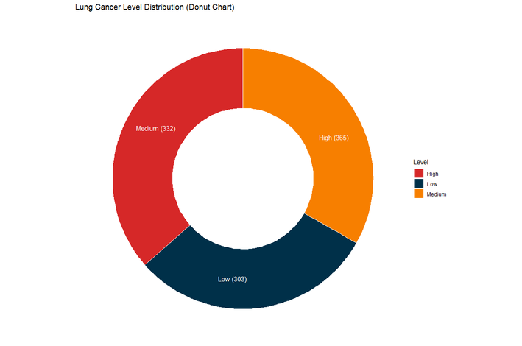


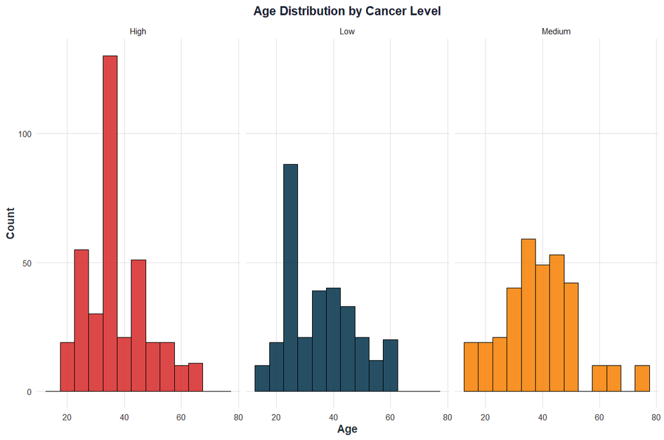

1. Distribution of Cancer Levels
The dataset is evenly distributed across Low, Medium, and High cancer levels. High has the largest count, but the differences are small. This balanced distribution reduces bias during model training.
2. Age and Cancer Severity
Most patients are between 25 and 50 years old. ANOVA shows a significant difference in age across cancer levels (p = 0.00328). Highseverity cases tend to appear in older age groups, while Lowseverity cases are more common in younger adults.
4

Slide 7
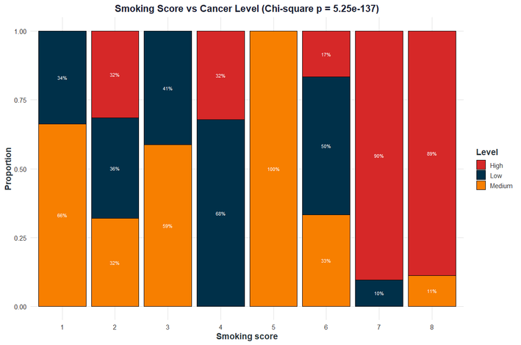
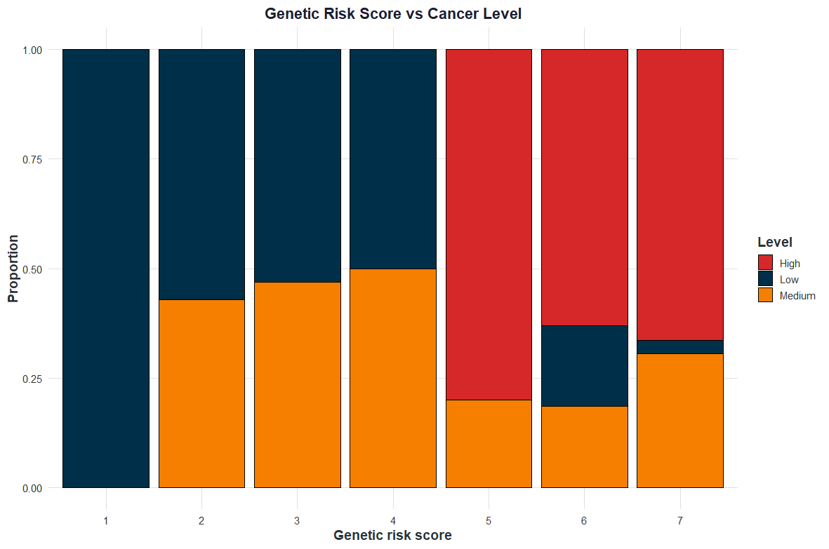

3. Smoking Severity and Cancer Level
Smoking shows a very strong association with cancer severity (Chisquare p < 2.2e16). Low and Medium levels dominate smoking scores from 1 to 4. High severity becomes dominant at scores 6, 7, and 8, where High reaches more than 85 percent of cases.
4. Genetic Risk and Cancer Level
Genetic risk is another strong predictor (Chisquare p < 2.2e16). Low and Medium levels dominate scores from 1 to 3. High becomes the majority starting at score 5 and reaches full dominance at score 7. This pattern shows that genetic predisposition contributes meaningfully to severity.
5

Slide 8

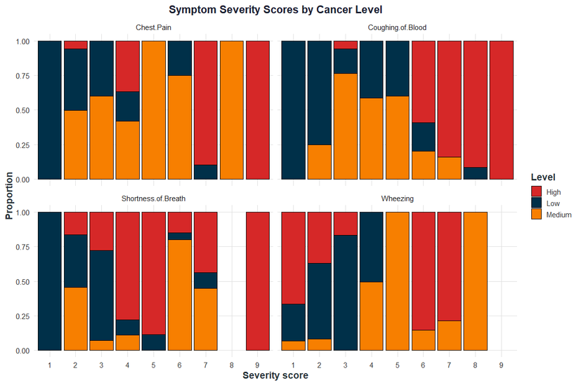
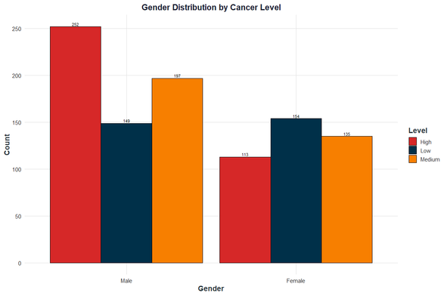
5. Symptom Severity and Cancer Level
Key symptoms such as shortness of breath, wheezing, coughing blood, and chest pain increase sharply with cancer severity. Highseverity patients consistently show the highest symptom scores. These symptoms align with the clinical presentation of advanced lung disease.
6. Gender Distribution by Cancer Level
Male patients show higher counts of Highseverity cases, while female patients show more Low and Medium cases. Gender plays a role but is not as strong a predictor as smoking or symptoms.
6

Slide 9
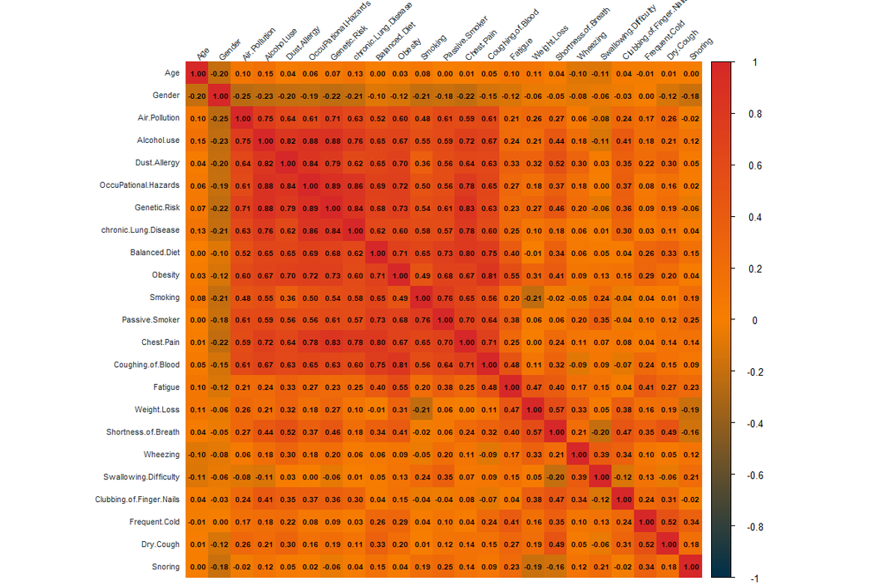
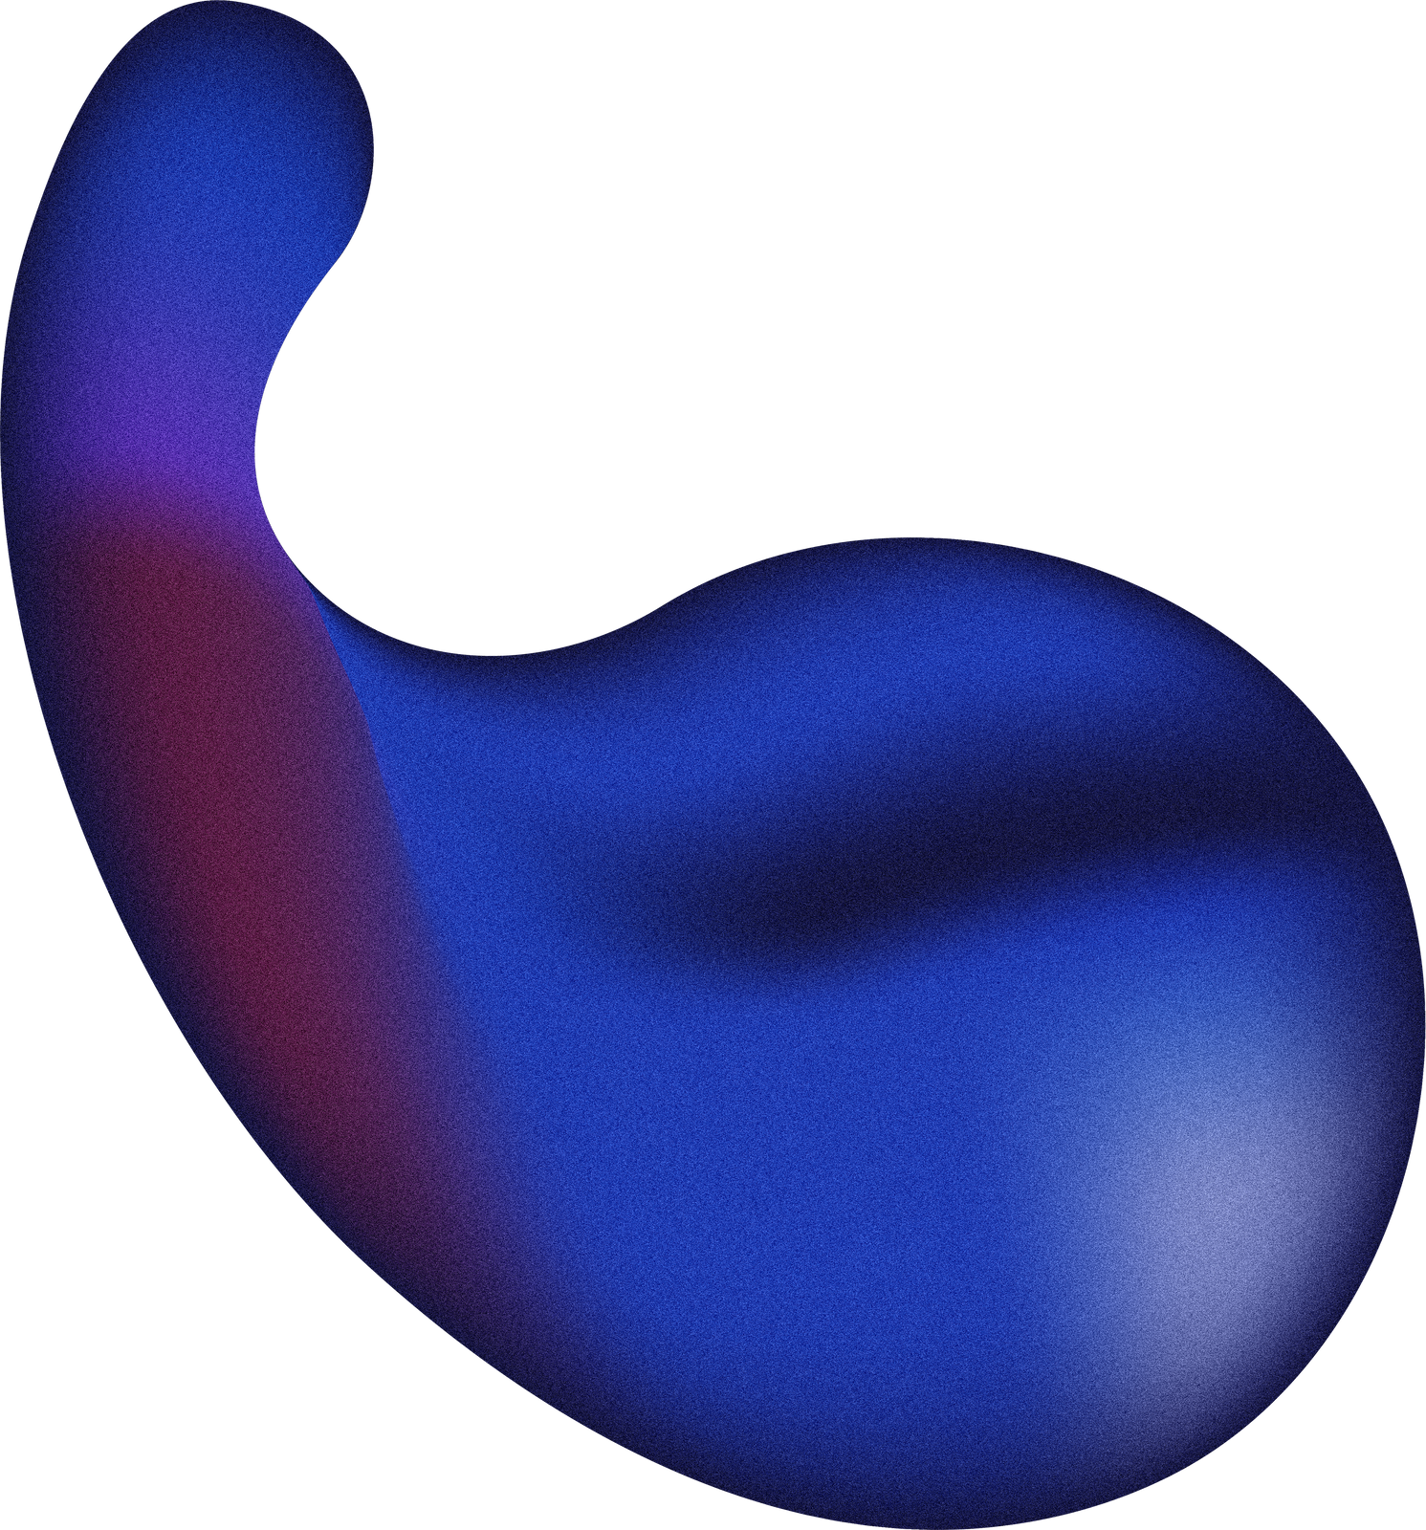
7. Correlation Heatmap
The heatmap shows strong correlations among respiratory symptoms, suggesting they often occur together. Smoking, alcohol use, obesity, and passive smoking also cluster together. In contrast, age, gender, and genetic risk have weaker correlations with most variables.
7

Slide 10
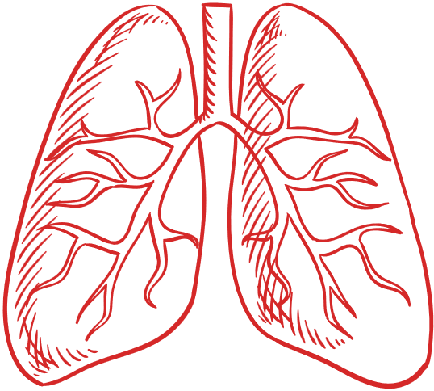
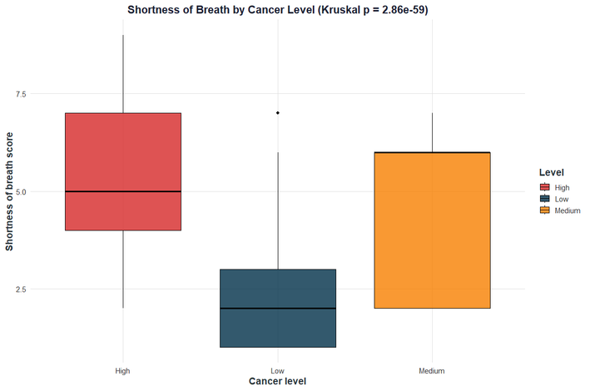
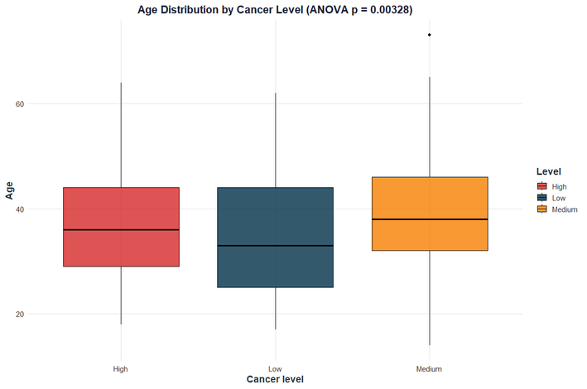

8. Statistical Tests Summary
Age (ANOVA p = 0.00328): The average age differs significantly across severity groups. High-severity patients typically fall in their late 30s or early 40s.
Smoking (Chisquare p < 2.2e16): High severity is strongly associated with high smoking scores. Score 7 shows about 90 percent high-severity cases.
Genetic Risk (Chi-square p < 2.2e16): High severity becomes dominant at genetic risk score 5 and reaches 100 percent at score 7.
Shortness of Breath (Kruskal p < 2.2e16): Median scores differ by severity group. High shows a median around 5, Medium around 4, and Low around 2.
8

Slide 11
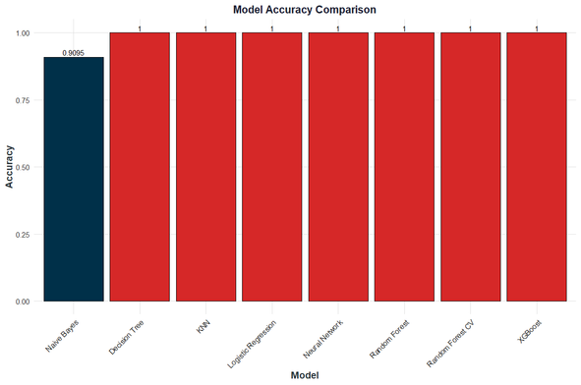
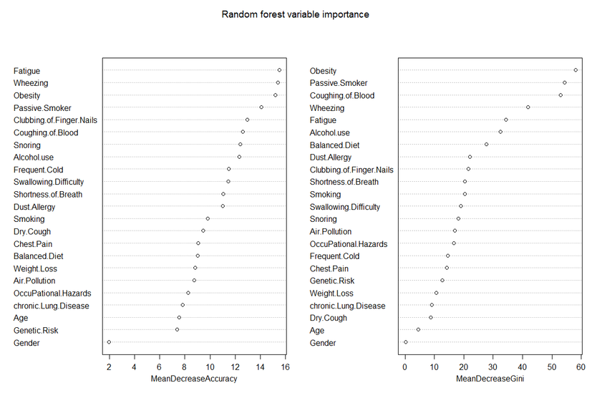
Model Performance
All models were trained on the dataset, including Logistic Regression, Decision Tree, Random Forest, KNN, XGBoost, Naive Bayes, and a Neural Network. Except for Naive Bayes, every model achieved 100 percent accuracy on the test set.
Why the Models Achieved 100 percent Accuracy ?
The dataset is synthetic and highly structured, with clear boundaries between Low, Medium, and High levels.
Key predictors such as smoking score, symptom severity, and genetic risk separate the classes almost perfectly.
There is no missing data, noise, or contradictory patterns.
Symptoms rise in a consistent pattern from Low to Medium to High, making classification straightforward.
Models that rely on linear separation, distance measures, or decision boundaries all find clean splits.
Naive Bayes achieved lower performance because it assumes independence between features, yet many symptoms and risks are correlated.
9

Slide 12
Conclusion and Recommendations
The dataset displays clear and consistent patterns connecting symptoms, lifestyle behaviors, and genetic factors to lung cancer severity. These relationships are strong and show minimal overlap between severity groups. Because the dataset is clean, structured, and synthetic, the models achieve perfect accuracy.
All major machine learning models reach 100 percent accuracy because:
The severity levels are cleanly separable based on the predictors.
Symptoms and risk factors follow consistent and predictable increases across severity levels.
There is no noise, missing data, or conflicting patterns.
Severe cases show extreme values that make classification straightforward.
Next steps
#
Recommendations
Priority
1
Use symptom severity, smoking behavior, and passive smoking exposure as primary indicators for rapid screening.
HIGH
2
Retrain the models on real clinical data to evaluate performance in real settings.
HIGH
3
Combine lifestyle factors with symptom patterns to support early diagnosis.
MEDIUM
4
Validate the models across different medical centers to ensure generalizability.
LOW
10

Slide 13

Thank you!
11

Slide 14
Resources and code
Dataset:
https://www.kaggle.com/code/takkimsncn/lung-cancer-prediction
R-file:
Double click on the file to open it ☺
12

Slide 15
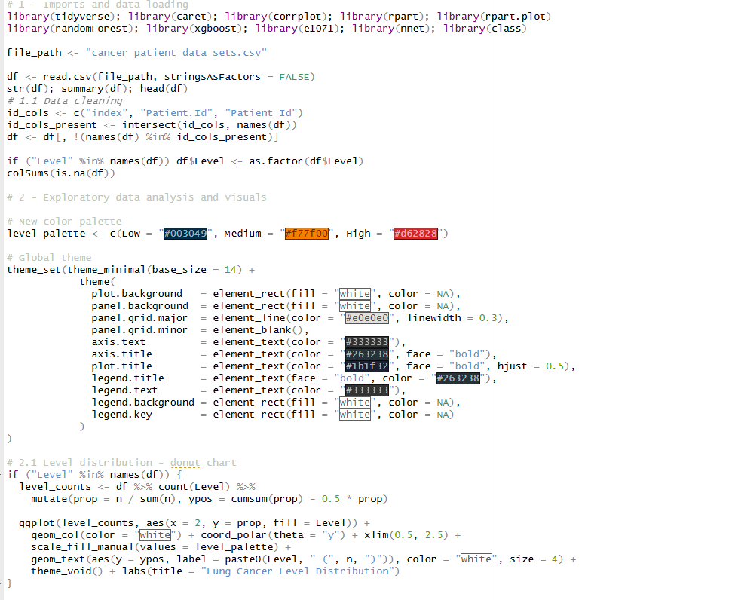
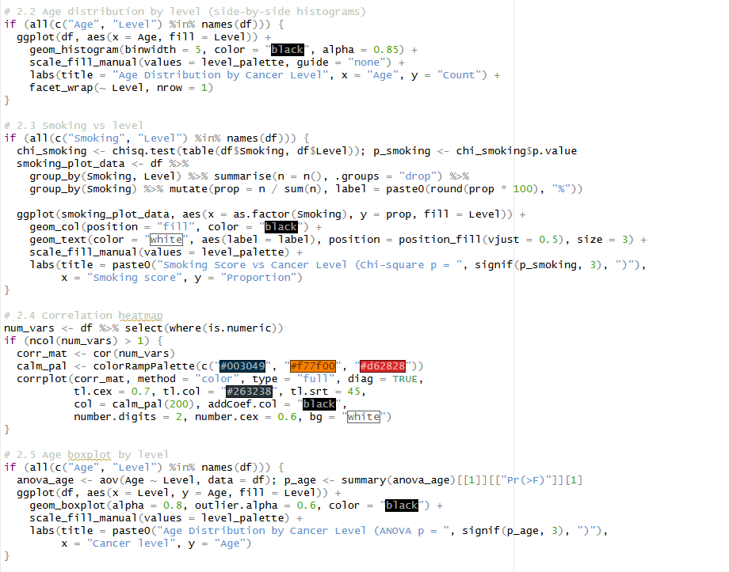

Slide 16
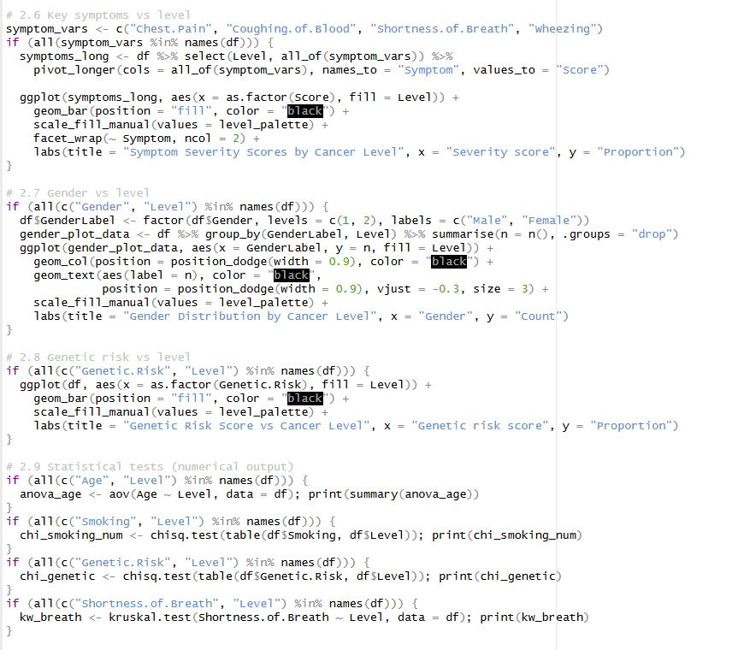
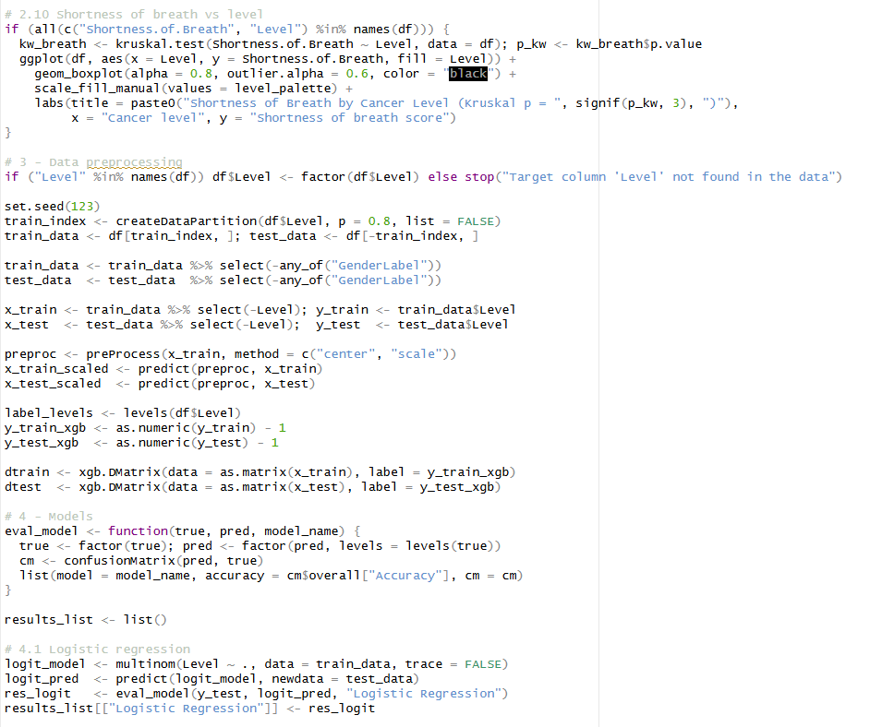

Slide 17
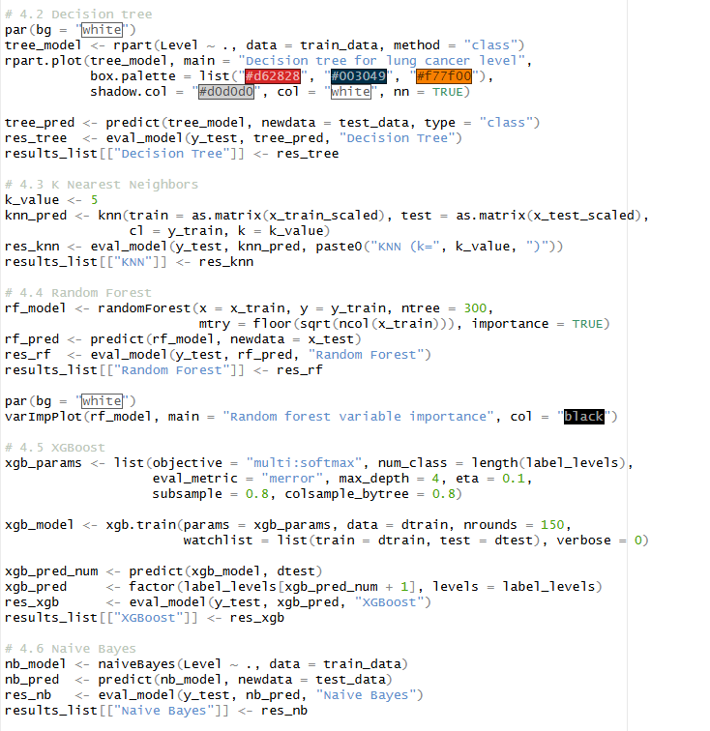
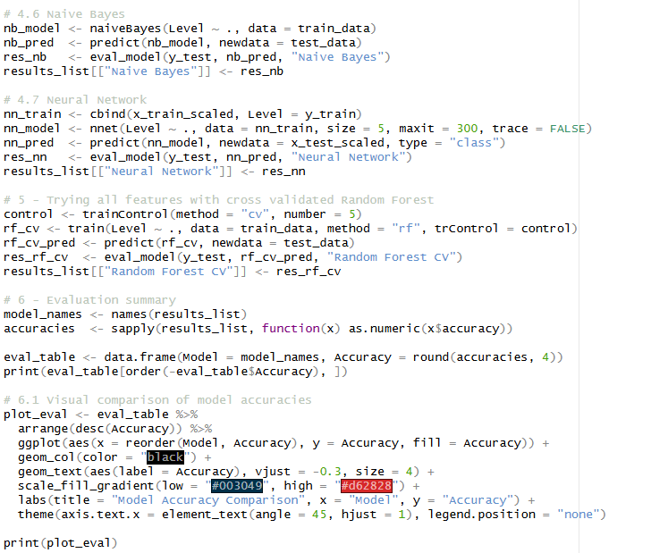

Slide 18
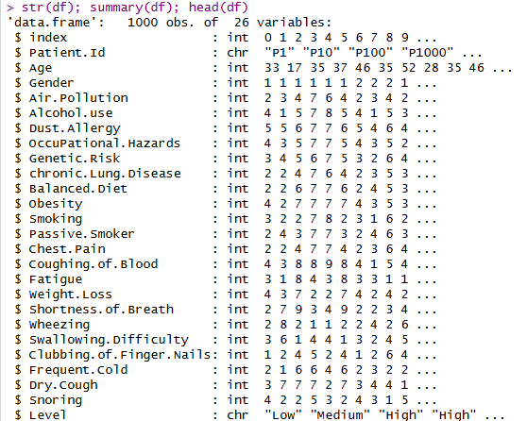
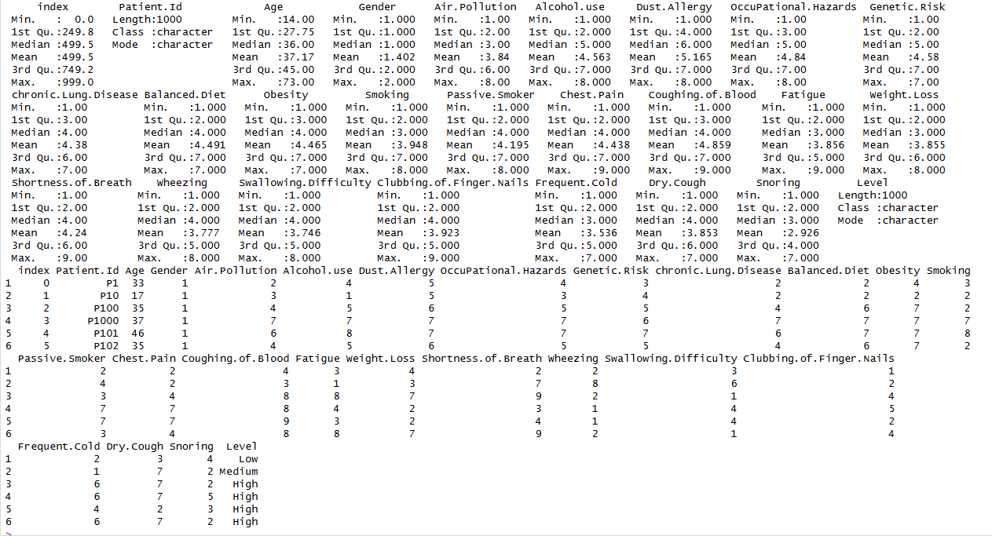

Slide 19
